Slide 1

Hospital Management System
Project GN2

Slide 2
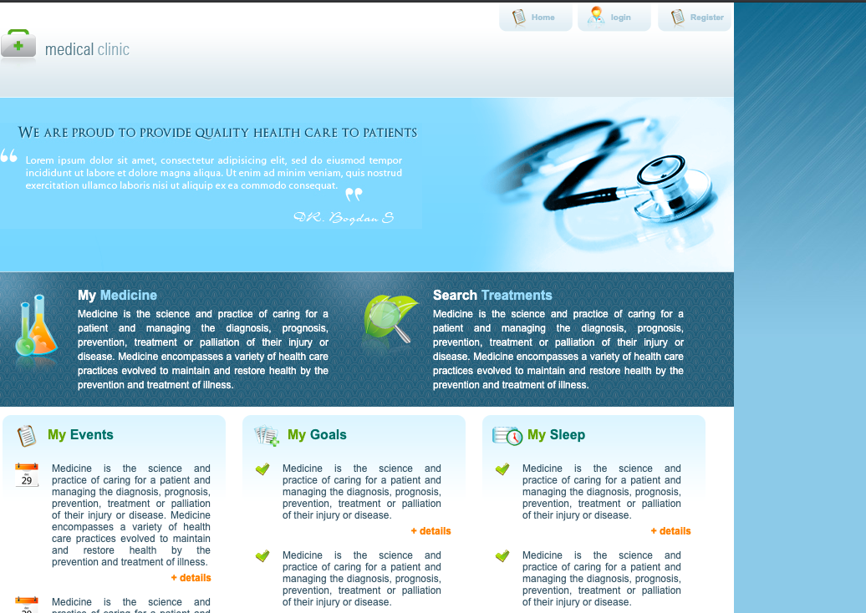
Project GN2 - Hospital Management System
Team – GN2
Joan
George
Naqash
Notes:
We are team GN2 and our task was to design and deploy a Hospital Management System

Slide 3
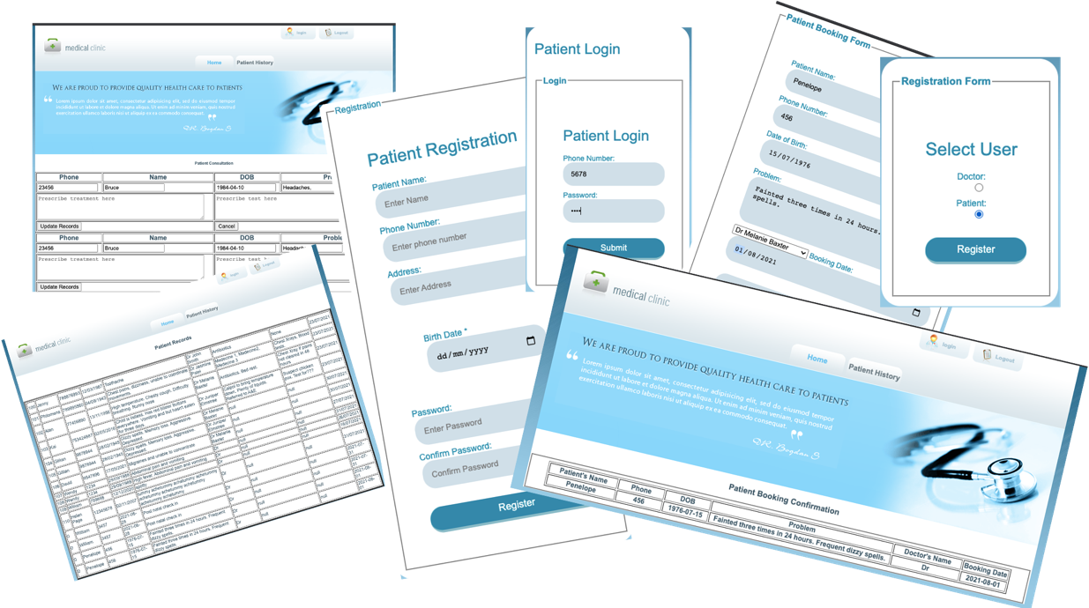


Purpose and Modules
Notes:
Thank you Joan, I’ll will be talking about the purpose and modules for this project. As we now know we the team worked on a hospital management system, and the purpose of this was to be able to develop a system that allows patients to book medical appointments with a doctor and also the doctors been able to prescribe tests and treatments for their patients. 7 modules that were achieved for this project Were 3 for the patients and 4 for the doctors Patient Registration Patient Login Patient Booking Doctor Registration Doctor Login Patient Consultation by doctor Patient History -due to the nature of this project we decided not to have a delete function to be able to keep patient previous data secured in the database incase if the doctor needed to see a patients previous history.

Slide 4


Approach
This Photo by Unknown Author is licensed under CC BY-NC
This Photo by Unknown Author is licensed under CC BY-ND
Notes:
We began by designing the structure and web layout
We met online at least three times a week and collaborated in remote workshops. Initially we all coded at the same time but this caused version integrity issues. So one of us coded and the others assisted with input regarding the coding solutions
We documented progress using word to update project documentation and the powerpoint design to keep us on track and execute version control
We used continuous improvement and the test and fail approach extensively since we did not have a clear understanding of how the code fit together

Slide 5
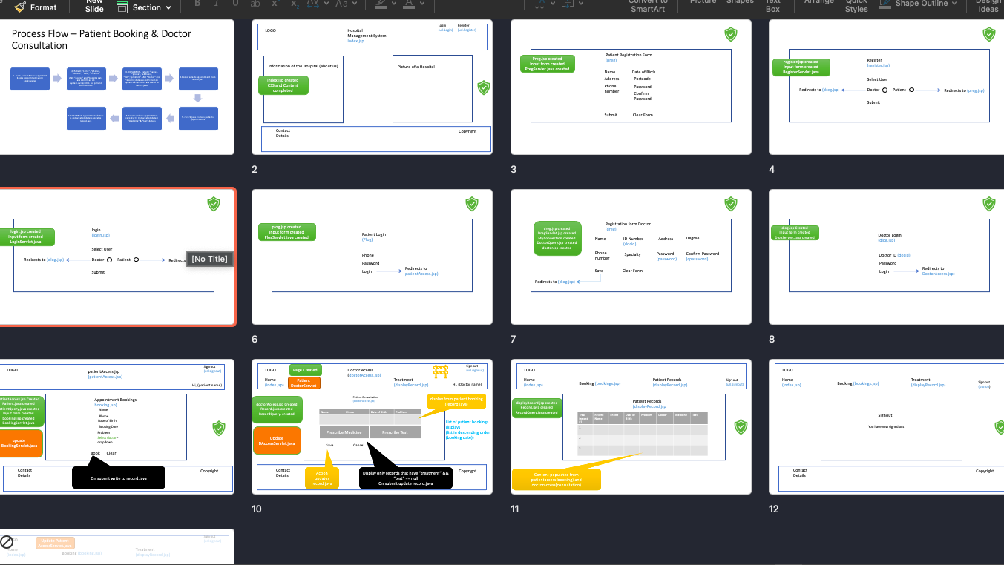
Planning & Continuous Improvement

Slide 6
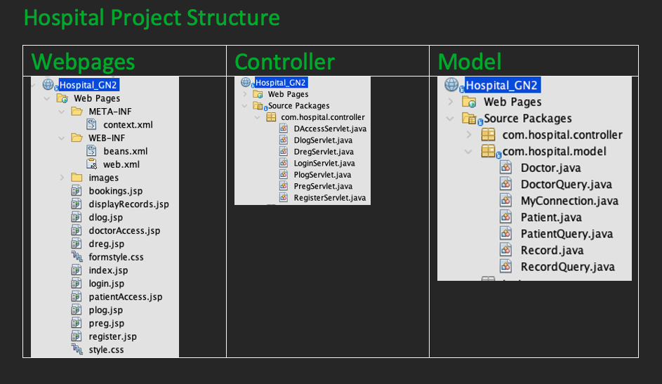
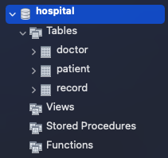
The Structure
Notes:
We the team made use of NetBeans as our IDE Environment, and in building this we made use of the MVC model in Java which stands for Model view and controller
M- class, queries, connections setup
V- Web pages using jsps
C- servlets
We made use of MySQL for the database
Ensure all java libraries and the jar are in place
We made use of Servers – Glass fish and Tom cat due to the different NetBeans Apache editions we the team have

Slide 7
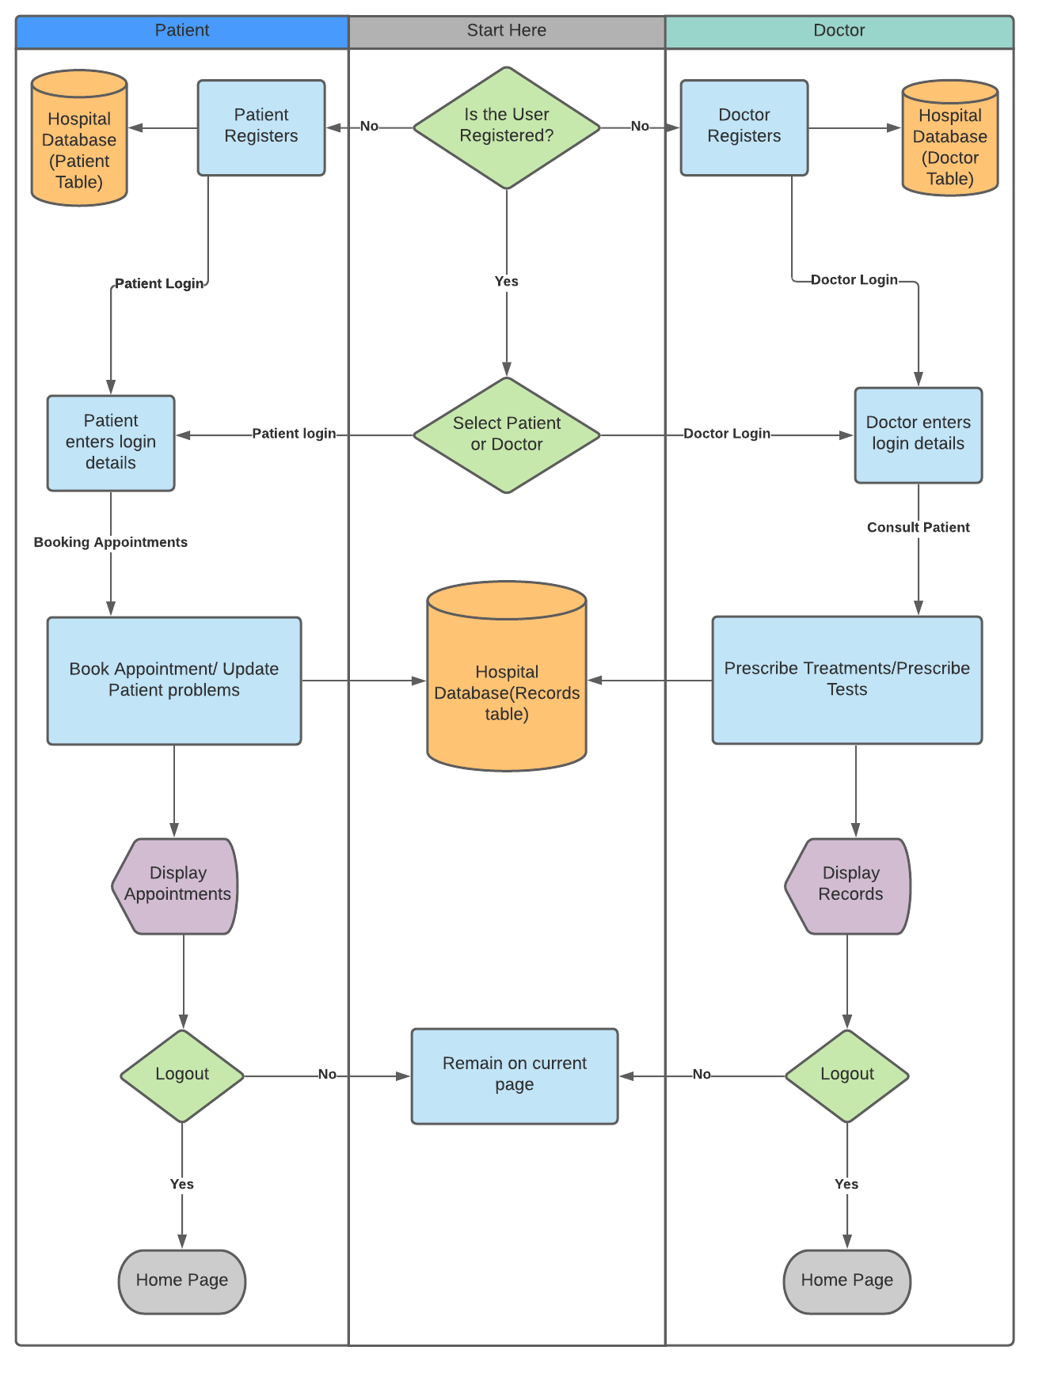

Slide 8
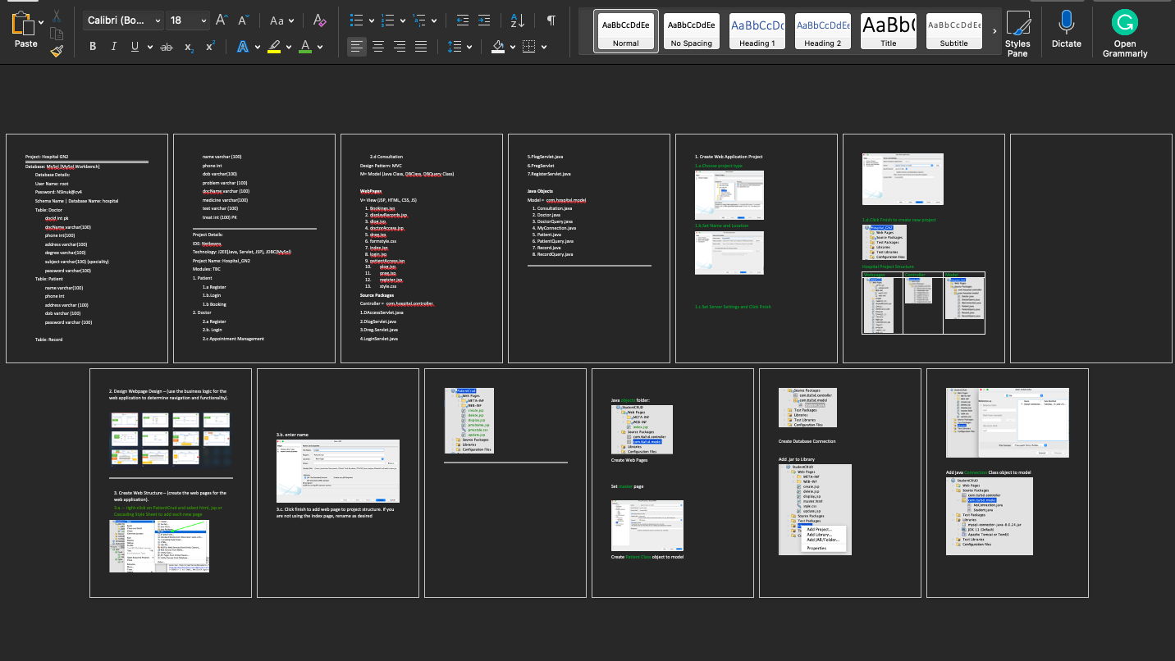
Documentation
Notes:
In the documentation , we had to ensure all the project was fully documented. The document is available should anyone need it.

Slide 9
Present Project & Website

Slide 10


Challenges
Notes:
Technology
It was impossible to smoothly share using GitHub since George was using glassfish and we were using tomcat. This meant a lot more time was spent debugging than coding, especially during the first week because we didn’t know that the different versions of Apaché broke the code.
Github navigation – we did not use it effectively since team members were unable to grasp the usage concept
Not knowing what we don’t know – it meant we didn’t know where to look for help or short cuts

Slide 11

Lessons Learned
Ask for help sooner
Google more
Assign tasks to team members
Debugging is the fastest way to understand coding
Understanding the MVC and its usage
Using the pallet to build responsive forms
Learning to read the Error Log accelerated the debugging

Slide 12
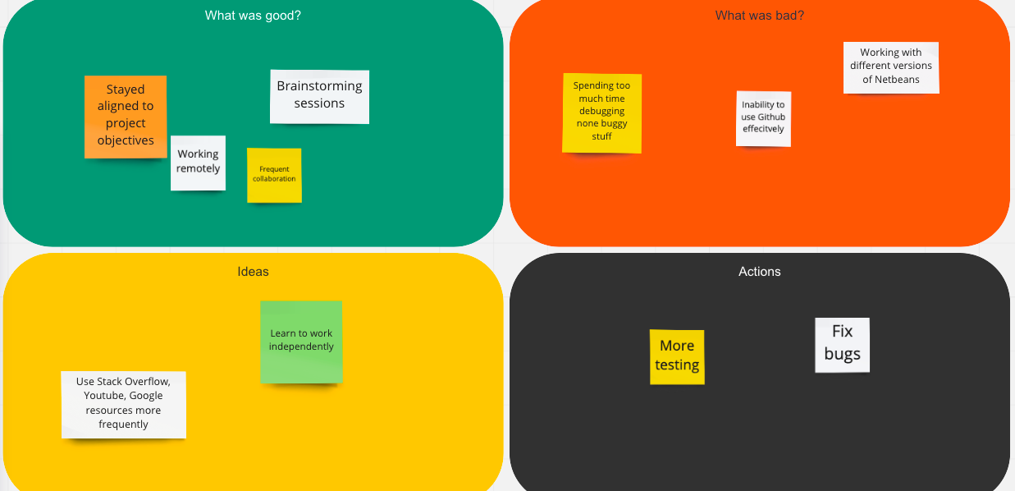
Stop Start Continue
Notes:
-Stop cramming long working sessions
- Start working independently and learn how to integrate github updates effectively.
- Start involving more people to test the development.
- Continue regular working patterns and updating documentation as changes are made

Slide 13

Thank You
Notes:
Any Questions?

